Slide 1
Chapter 8
Statistical Intervals Based for a Single Sample

Slide 2
Introduction
Now we talk about interval estimates versus point estimates. These interval estimates are called confidence intervals.

Slide 3
Confidence Intervals
In general, a 100(1 - α)% confidence interval (c.i.) for a parameter θ is (L, U) such that
P(L ≤ θ ≤ U) = 1 – α.
L and U are functions of a random sample
X₁ ,…,X_{n}. Note that (1 – α) is called the
confidence coefficient.
Notes:
SKIPPING ONE-SIDED CONFIDENCE INTERVALS!

Slide 4
Confidence Intervals
Once the random sample is observed
(x₁ ,…,x_{n}), the resulting c.i. is (l, u), where l and u
are the corresponding functions of the observed
random sample (x₁ ,…,x_{n}).

Slide 5
Confidence Intervals
Assume X₁ ,…,X_{n} is a random sample from a N(μ, σ²) population where μ is unknown and σ² is known.
We want a 100(1 - α)% c.i. for μ.
Typically 100(1 - α)% is 90%, 95%, and 99%.

Slide 6

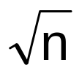
Note: is N(μ, σ²/n). Hence,
Z = - μ is N(0,1).
σ/
Notation: Let z_{α} be the special value such
that P(Z > z_{α} ) = α.

Slide 7
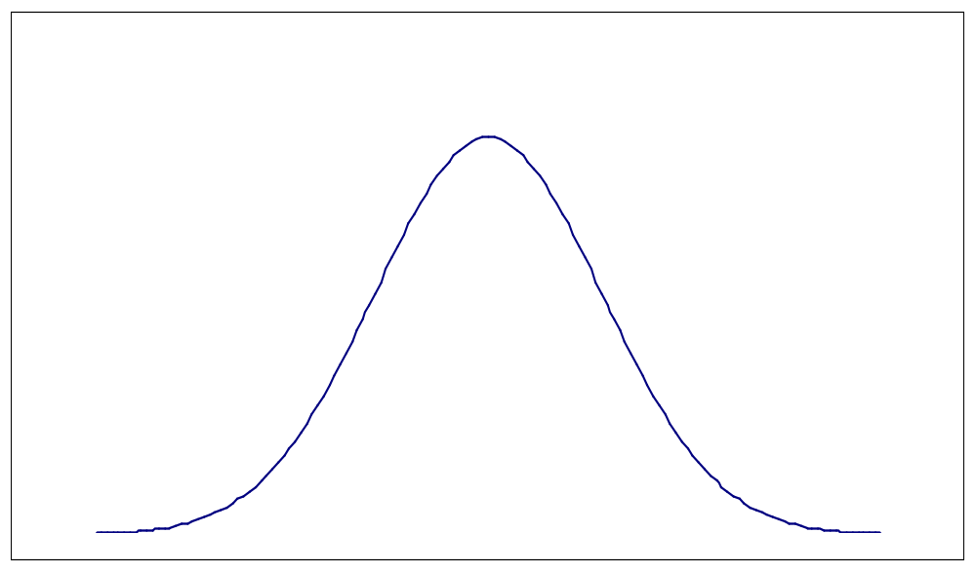
|
|
|
α
_____________________________________
0 z_{α}

Slide 8
EXA Find z_{.01}, z_{.05}, and z_{.025}.
Note: P(-z_{α/2} < Z < z_{α/2} ) = 1 - α.
Notes:
z_{.01} = 2.33 z_{.05} = 1.645 z_{.025} = 1.96

Slide 9
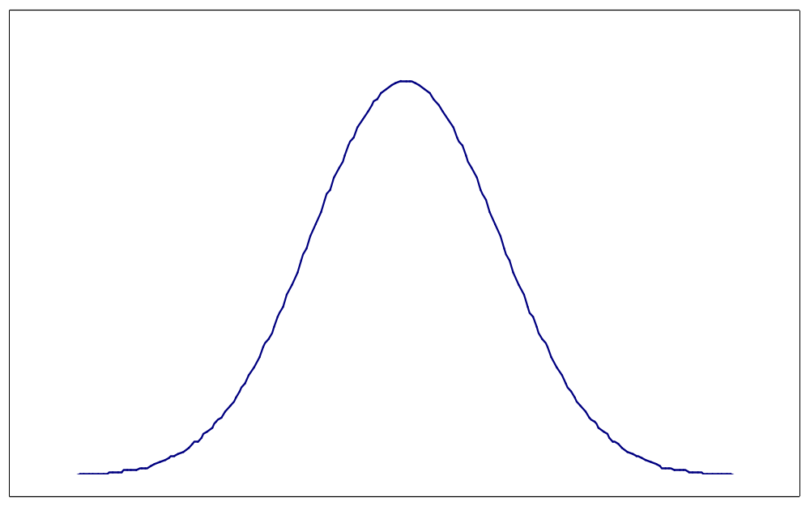
1 - α
|
|
|
|
|
|
|
|
α/2
α/2
________________________________________
-z_{α/2} 0 z_{α/2}

Slide 10
How we get the c.i.
-z_{α/2} < Z < z_{α/2} iff
-z_{α/2} < - μ < z_{α/2} iff
σ/√n
-z_{α/2} σ/√n < - μ < z_{α/2} σ/√n iff
- z_{α/2} σ/√n < μ < + z_{α/2} σ/√n

Slide 11
How we get the c.i.
Hence,
P( - z_{α/2} σ/√n < μ < + z_{α/2} σ/√n) = 1 - α.
Hence, the probability that the random interval
( - z_{α/2} σ/√n , + z_{α/2} σ/√n) contains μ is
(1 - α).

Slide 12
100(1 - α)% c.i. for μ
A 100(1 - α)% c.i. for μ is
± z_{α/2} σ/√n .
Terminology:
± z_{α/2} σ/√n
↑ ↑ ↑
point estimator critical standard deviation of
for μ value point estimator

Slide 13
Margin of Error
z_{α/2} σ/√n z_{α/2} σ/√n
<-------------------><------------------->
___________________________________
Note: z_{α/2} σ/√n is called the margin of error.
Length = 2 x (margin of error). Both length and margin of error are measures of precision.
|

Slide 14
Critical Values
Below is a chart of the critical values for the common confidence levels.
100(1 - α)% | 90% 95% 99%
z_{α/2} | 1.645 1.96 2.576
Notes:
Go thru the arguments for the chart.

Slide 15
Confidence Interval for μ
EXA Stray-load loss is N( ? , 9). The sample mean was 58.3.
a. Find a 95% c.i. for μ when n = 25.
b. Find a 95% c.i. for μ when n = 100.
c. Find a 99% c.i. for μ when n = 100.
Notes:
a. 58.3 ± (1.96)(3/5) = 58.3 ± 1.176 -----> (57.124, 59.476)
b. 58.3 ± (1.96)(3/10) = 58.3 ± .588 -----> (57.712, 58.888)
c. 58.3 ± (2.576)(3/10) = 58.3 ± .773 -----> (57.527, 59.073)

Slide 16
Observations from Example
Note: As the sample size increases, the c.i.
gets narrower (or decreases in length).
We saw this when we went from a to b.
Note: As the confidence level increases, the
c.i. gets wider (or increases in length).
We saw this when we went from b to c.

Slide 17
Meaning of a 95% c.i.
1. Probability that the random interval
± (1.96) σ/√n covers μ equals .95 ???
2. Probability that μ is in (57.124, 59.476) (Example, part a) is .95 ???
3. In repeated sampling, 95% of the resulting confidence intervals will contain μ and 5% will not ???
Notes:
1. Yes
2. No
3. Yes

Slide 18
Meaning of a 95% c.i.
Consider a simulation to help understand the meaning of a 95% confidence interval for a population mean.
We take a random sample of size 20 from a N(67,9) population. Pretend we don’t know μ = 67.

Slide 19
Meaning of a 95% c.i.
muci=matrix(0,2,100)
j=0
for(i in 1:100)
{
xbar=mean(rnorm(20,67,3))
muci[1,i]=xbar-1.96*3/sqrt(20)
muci[2,i]=xbar+1.96*3/sqrt(20)
if((67 > muci[1,i]) && 67 < muci[2,i])
j=j+1
}
j
Notes:
Expect j to be around 95. Type “muci” in R and you can see the 100 resulting ci’s.

Slide 20
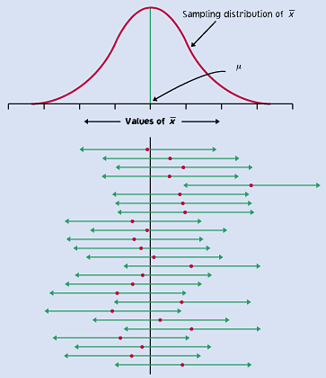
Meaning of a 95% c.i.

Slide 21
Precision of c.i.
Note: The precision or accuracy of a confidence interval is measured by the length of the c.i. As the confidence level increases, the precision of the c.i. decreases.
Note: A 100% c.i. for μ is (-∞, ∞) - not very precise.

Slide 22
Choice of Sample Size
We can specify the confidence level,
100(1-α)%, and the length, L, of the c.i. and
find n to meet these specifications.
L = 2 z_{α/2} σ/√n
iff n = (2z_{α/2} σ/L)² .

Slide 23
Choice of Sample Size
n = (2z_{α/2} σ/L)²
EXA Say we want a 99% c.i. of length 1 assuming a standard deviation of 3.
Notes:
n = (2(2.576)(3)/1)² = 238.9
So n = 239

Slide 24
Large Sample c.i.’s for μ
Assume X₁ ,…,X_{n} is a random sample from a population with mean μ and variance σ² where μ is unknown and σ² is known.
By CLT, is approximately N(μ, σ²/n)
for large n.

Slide 25
Large Sample c.i.’s for μ
By the same argument as before,
± z_{α/2} σ/√n
is an approximate 100(1-α)% c.i. for μ.

Slide 26
What if σ is unknown?
For large n, s will be close to σ. So we can say that
- μ is approximately N(0,1) for large n.
S/√n

Slide 27
What if σ is unknown?
By similar argument as before,
± z_{α/2} S/√n
is an approximate 100(1-α)% c.i. for μ.

Slide 28

General Case
θ - parameter of interest
- point estimator of θ
- θ is approximately N(0,1)
σ

Slide 29
General Case
Recall that P(-z_{α/2} < Z < z_{α/2} ) ≈ 1 - α.
Using Z as just defined, this probability
statement is equivalent to:
P( - z_{α/2} σ < θ < + z_{α/2} σ ) ≈ 1 - α.

Slide 30
General Case
Hence, ( - z_{α/2} σ , + z_{α/2} σ )
is an approximate 100(1 - α)% c.i. for θ.
Note: If the standard deviation of contains unknown parameters, estimate those parameters by the appropriate point estimators then substitute in interval above.

Slide 31
Application
(1) θ = μ, = , σ = σ/√n ,
estimated σ is S/√n (just did!!)
± z_{α/2} σ/√n
± z_{α/2} S/√n

Slide 32

Application
(2) Let X be a Binomial(n, p) rv.
We want a 100(1 - α)% c.i. for p.
We know that is approximately
N(p, p(1 - p)/n).
Here θ = p, = , and estimated standard deviation of is ???
Notes:
Recall = x/n

Slide 33
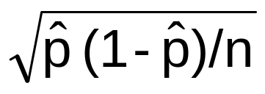
Application
(2) Let X be a Binomial(n, p) rv.
Hence, ± z_{α/2}
is an approximate 100(1 - α)% c.i. for p.
(We can use this c.i. when n ≥ 10
and n(1 - ) ≥ 10.)

Slide 34
EXA Let p denote the proportion of adult Americans who described the Bill of Rights as the first 10 amendments to the U.S. Constitution. Out of a random sample of 507 American adults, 142 correctly described the Bill of Rights.
x = 142 n = 507
(this is the correct definition of the Bill of Rights)
Notes:
= 142/507 =.28
A 99% c.i. for p is
.28 ± 2.576 √(.28)(.72)/507 = .28 ± .05
→ (.23, .33)

Slide 35
C.I. For a Normal Mean, σ Unknown
Assume X₁ ,…,X_{n} is a random sample from a
N(μ, σ²) distribution where μ and σ² are
unknown.
If n is large, ± z_{α/2} S/√n is a 100(1 - α)%
c.i. for μ as discussed previously.
We now assume n is small.

Slide 36
C.I. For a μ, σ Unknown, n Small
Thm T = ( - μ)/(S/√n) has a t-distribution
with (n - 1) degrees of freedom (d.f.)
under our assumptions.
What is a t-distribution?
Notes:
Write down pdf on page 283.

Slide 37
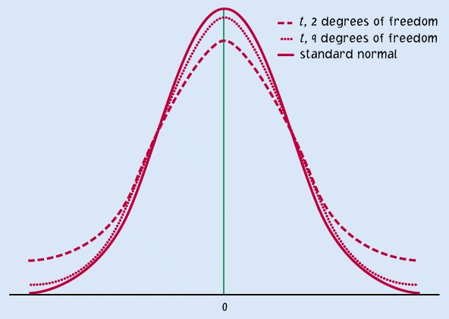
t(d.f.) versus N(0,1)

Slide 38
Properties of t-distribution
Let ν denote the degrees of freedom (d.f.).
1. t-curve is bell-shaped and centered at 0.
2. t-curve is more spread out than N(0,1) curve
(has heavier or flatter tails).
3. As ν increases, spread of t curve decreases.
4. As ν increases, t curve approaches N(0,1)
curve.

Slide 39
Notation: P(T > t_{α,ν}) = α
|
α
|
0
t
α,ν

Slide 40
t distribution
See Table V in Appendix.
EXA t_{.05,20} =
t_{.01,6} =
t_{.05,∞} = z_{.05} =
Notes:
1.725
3.143
1.645

Slide 41
100(1 - α)% c.i. for μ
Note: P(- t_{α/2,n-1} < T < t_{α/2,n-1}) = 1 - α ,
where T ~ t(n - 1).
-t_{α/2,n-1} < - μ < t_{α/2,n-1} iff
S/√n
- t_{α/2,n-1} S/√n < μ < + t_{α/2,n-1} S/√n

Slide 42
100(1 - α)% c.i. for μ
Hence,
± t_{α/2,n-1} S/√n
is a 100(1 - α)% c.i. for μ.

Slide 43
EXA Trisodium carboxymethylaxysuccinate
(NaCMOS) is a chemical compound being
considered for inclusion in various detergent
products. Since it would eventually become a
component of wastewater, six goldfish were
exposed to 100 mg of NaCMOS for a 16 hour
period and their NaCMOS content was
determined. This resulted in a sample mean
and standard deviation of 9.1 and 3.2, resp.
Give a 90% c.i. for μ = mean ????.
Notes:
= 9.1, s = 3.2
μ = mean NaCMOS content for goldfish undergoing such exposure
A 90% c.i. for μ is 9.1 ± (2.015)(3.2)/√6 = 9.1 ± 2.63
↑
t_{.05,5}
→ (6.47, 11.73)

Slide 44
Comments
1.We cannot really control the length of a t-
interval due to σ being unknown and s may
not necessarily be real close to σ for small n.
2. t_{α/2,n-1} > z_{α/2} produces a wider c.i. than
naively using ± z_{α/2} S/√n to allow for the
fact that σ is being estimated by s.
3. The normal assumption is real important here.

Slide 45
Robustness
Defn A statistical inference procedure is
robust when the probability calculations
required are insensitive to violations of the
assumptions made.
Hence, a ci is robust when the confidence
level does not change very much when the
assumptions are violated.

Slide 46
Robustness
Comments:
1. t procedures are quite robust against non-normality of the population except in the case of outliers or strong skewness.
2. When non-normality is present, t procedures work well for large n.

Slide 47
Robustness
Rules of Thumb
1. n < 15 ⇒ data should be close to normal to use t procedures
2. n ≥ 15 ⇒ use t procedures unless there are outliers or strong skewness
3. Large n (n ≥ 40) ⇒ t procedures can be used.

Slide 48
Confidence Intervals for σ and σ²
Assume that X₁ ,…,X_{n} is a random sample
from a N(μ, σ² ) distribution.
Thm (n - 1)S² / σ² = Σ(X_{i} - )² / σ² has a
chi-squared distribution with (n - 1)
degrees of freedom. (χ² (n - 1))

Slide 49
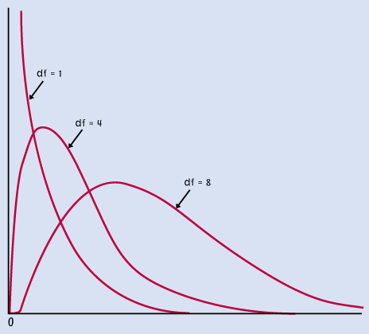
Chi-squared Distribution

Slide 50
Properties of Chi-squared
Let ν denote the d.f.
1. A χ² (ν) rv is positive.
2. A χ² (ν) rv has a distribution which is skewed to the right.
3. As ν increases, the curve moves to the right and becomes more symmetric.
4. We can’t assume symmetry about 0 as we did for t curve and N(0,1) curve.

Slide 51
Chi-squared Distribution
Let V ~ χ² (ν).
Notation: Let χ²_{α,ν} be the 100(1 - α)th
percentile of a χ² (ν) distribution.
i.e., P( V > χ²_{α,ν}) = α
Use Table IV in Appendix.
Notes:
Make graph.

Slide 52
Chi-squared Distribution
EXA Find χ²_{.05,10}, χ²_{.9,20} , P(χ² (10) > 3.25),
and P(χ² (10) < 4.87).
Notes:
χ²_{.05,10} = 18.31
χ²_{.9,20} = 12.44 MAKE GRAPHS!!!!!
P(χ² (10) > 3.25) = .975
P(χ² (10) < 4.87) = .1

Slide 53
Derivation of c.i. for σ²
P[χ²_{1-α/2,n-1} < (n - 1)S² / σ² < χ²_{α/2,n-1} ] = 1 - α
χ²_{1-α/2,n-1} < (n - 1)S² / σ² < χ²_{α/2,n-1} iff
(n - 1)S² / χ²_{α/2,n-1} < σ² < (n - 1)S² / χ²_{1-α/2,n-1}
Notes:
Make picture of probability statement.

Slide 54
Confidence Interval for σ²
∴ ((n - 1)S² / χ²_{α/2,n-1},(n - 1)S² / χ²_{1-α/2,n-1})
is a 100(1 - α)% c.i. for σ².
What is a 100(1 - α)% c.i. for σ?
Notes:
Give c.i.

Slide 55
Confidence Interval for σ²
EXA Random variable of interest is amount (in mls) of lateral expansion pulsed-power gas metal arc welds used in LNG ship containment tanks.
n = 9, s = 2.81
Give a 95% c.i. for σ² and σ.
Notes:
95% c.i. for σ² is (8(2.81)² /17.53 , 8(2.81)² /2.18) = (3.6035, 28.9765)
↓ ↓
χ²_{.025,8} χ²_{.975,8}
95% c.i. for σ is (√3.6035, √28.9765) = (1.8983, 5.3830)

Slide 56
Large Sample Confidence Interval for p
Let X be a Binomial(n, p) rv.
Hence, ± z_{α/2}
is an approximate 100(1 - α)% c.i. for p.
(We can use this c.i. when n ≥ 10
and n(1 - ) ≥ 10.)

Slide 57
Large Sample Confidence Interval for p
EXA Let p denote the proportion of adult Americans who described the Bill of Rights as the first 10 amendments to the U.S. Constitution. Out of a random sample of 507 American adults, 142 correctly described the Bill of Rights.
x = 142 n = 507
(this is the correct definition of the Bill of Rights) RECALL THIS EXAMPLE!!
Notes:
= 142/507 =.28
A 99% c.i. for p is
.28 ± 2.576 √(.28)(.72)/507 = .28 ± .05
→ (.23, .33)

Slide 58
Choosing the Sample Size
We want a 100(1 - α)% c.i. of length L.
L = 2 z_{α/2}
iff n = 4(z_{α/2} / L)² (1 - )
Now is unknown since n has not been
chosen yet.

Slide 59
Two Options
(1) If you have a rough guess what p is, use it.
Call it p*. Here
n = 4(z_{α/2} / L)² p* (1 - p*).

Slide 60
Two Options
(2) If you have no idea what p is, use p = 1/2.
Here
n = 4(z_{α/2} / L)² (1/2)(1/2) = (z_{α/2} / L)².
This is the most conservative choice for n.

Slide 61
Choosing the Sample Size
EXA We want a 95% c.i. for p with a margin of
error of 2 percentage points. We have no
guess for p.
Notes:
95% c.i. L = .04
n = (1.96/.04)² = 2401

Slide 62
Suggestion
Check out Section 8-5 for summary of our work in this chapter. Skipping rest of Chapter 8.

